Slide 1
Practice of Sampling Distributions and Estimations
MGMT 670: Business Analytics

Slide 2
Formulas
Sampling Distribution
Known stdev
Unknown stdev
Proportion

Slide 3
Sampling distribution
The manager of a grocery store has taken a random sample of 100 customers. The average length of time it took these 100 customers to check out was 3.0 minutes. It is known that the standard deviation of the population of checkout times is one minute. The population mean is μ (unknown).
What is the distribution of the sample mean?

Slide 5
Interval Estimation
The manager of a grocery store has taken a random sample of 100 customers. The average length of time it took these 100 customers to check out was 3.0 minutes. It is known that the standard deviation of the population of checkout times is one minute. The population mean is μ (unknown).
What is the 95% Confidence interval for the mean?

Slide 7
Interval Estimation
The manager of a grocery store has taken a random sample of 100 customers. The average length of time it took these 100 customers to check out was 3.0 minutes.
The sample standard deviation is one minute.
What is the 95% Confidence interval for the mean?

Slide 9
Interval Estimation
A new brand of chocolate bar is being market tested. Four hundred of the new chocolate bars were given to consumers to try. The consumers were asked whether they liked or disliked the chocolate bar. You are given their responses below.
Response Frequency
Liked 300
Disliked 100
Construct a 95% confidence interval for the true proportion of people who liked the chocolate bar.

Slide 11
Determine Sample Size
A new brand of chocolate bar is being market tested. Four hundred of the new chocolate bars were given to consumers to try. The consumers were asked whether they liked or disliked the chocolate bar.
With a .95 probability, how large of a sample needs to be taken to provide a margin of error of 3% or less?

Slide 12
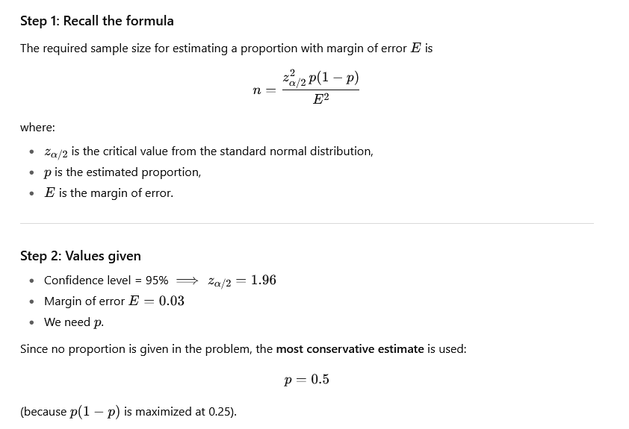

Slide 13
